Slide 1
Mutual Exclusion
Notes:
Explain The concept of the RPC.

Slide 2
Mutual Exclusion
Purpose
Critical Section
Cooperating Process
Methods
Centralized Algo
Distributive Algo
Token Ring Algo
Notes:
Explain The concept of the RPC.

Slide 3
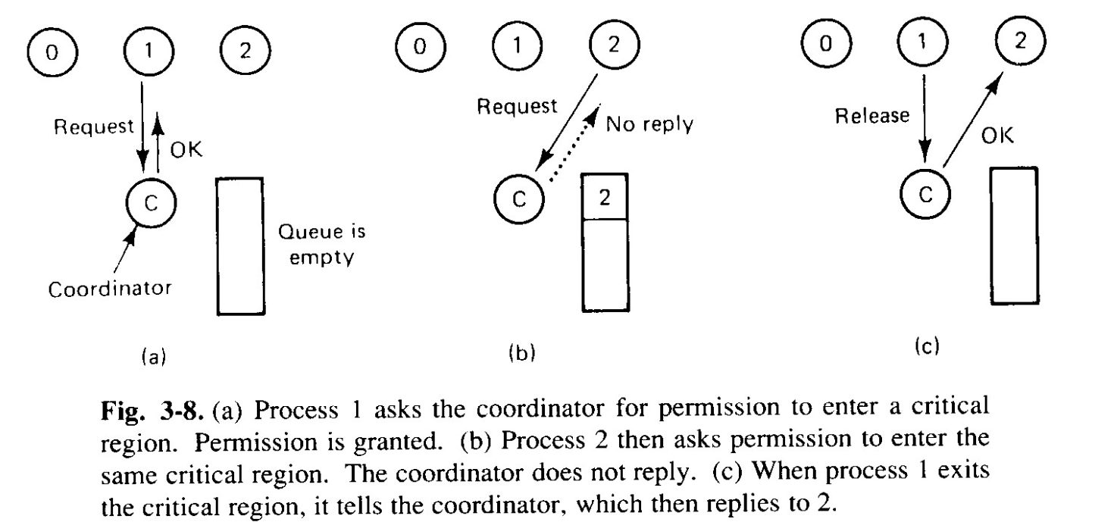
Centralized Algo
Role of Coordinator
Maintains a queue

Slide 4
Centralized Algo
When process exits from critical section, first item from the queue of deferred requests is invoked.
Issues:
Single point of failure
Performance bottleneck

Slide 5
Distributive Algo
Works on principle of ordering
Unambiguous
Process willing to enter in a critical section builds a message
Critical section name
Its Process number
Current time
Sends message to all including itself
Assumes reliable communication

Slide 6
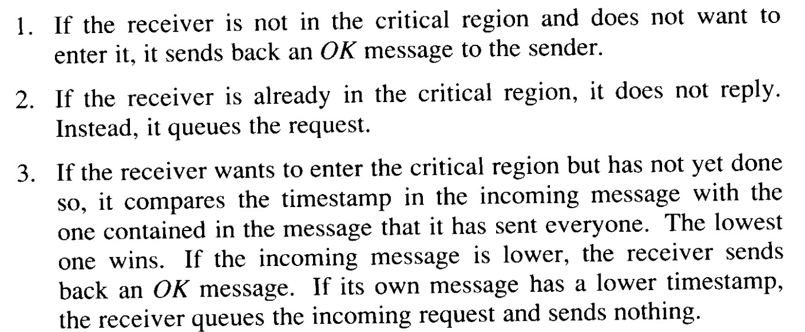
Distributive Algo: Ricart and Agrawala's algorithm
When process receives a request:

Slide 7
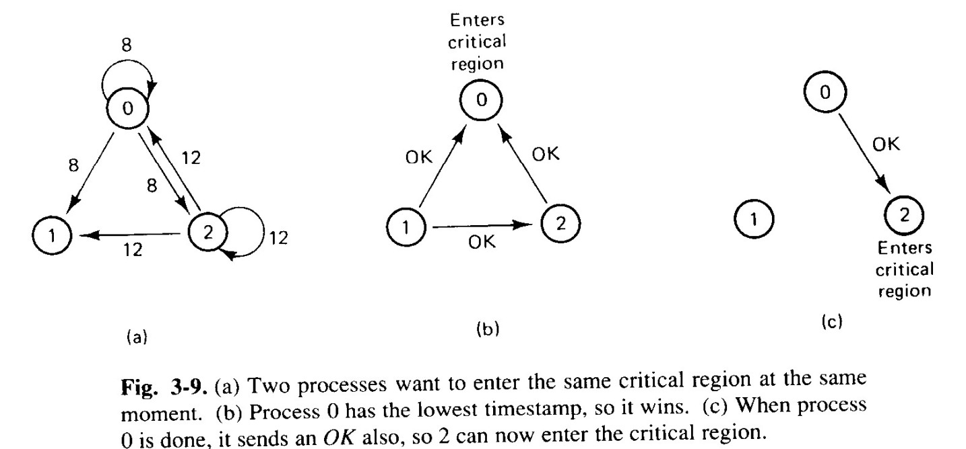
Distributive Algo: Ricart and Agrawala's algorithm

Slide 8
Distributive Algo: Ricart and Agrawala's algorithm
Issues:
Single point failure is replaced by n point failure
What if one system fails
Solution
Time-out
All processes are involved in all decision making
Solution
Prevent 2 processes to enter at a time
Instead of waiting for all, wait for majority
Need group membership
Process entering the group
Leaving group

Slide 9
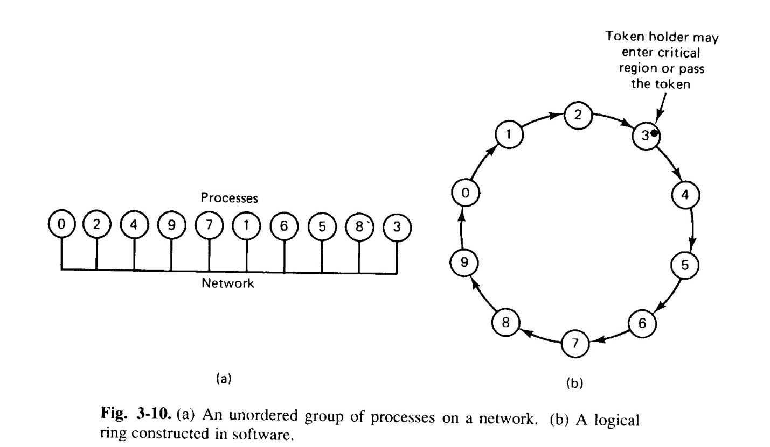
Token ring
Based on concept of token in ring topology

Slide 10
Token ring
Issues
What if token is lost
If one system dies

Slide 11
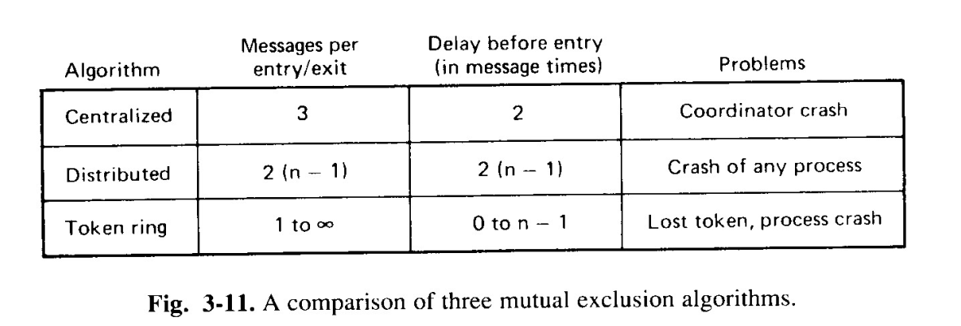
Comparison

Slide 12
Reference
A S Tanenbaum, Maarten Van Steen, Distributed Operating systems, Pearson, 2014

